Slide 1
Competitive advantage
Lecture 2
IT Strategy

Slide 2
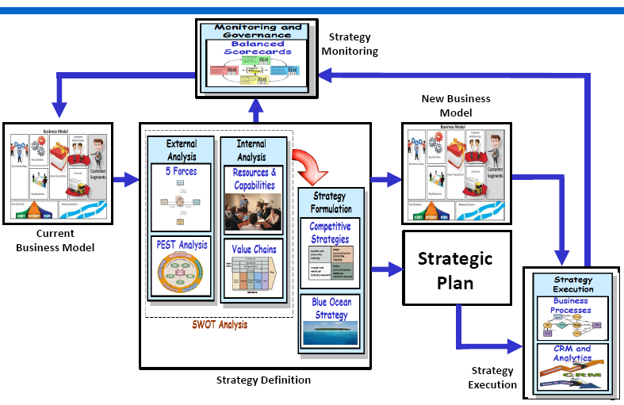
Competitive advantage External analysis

Slide 3
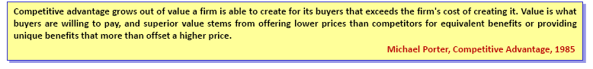
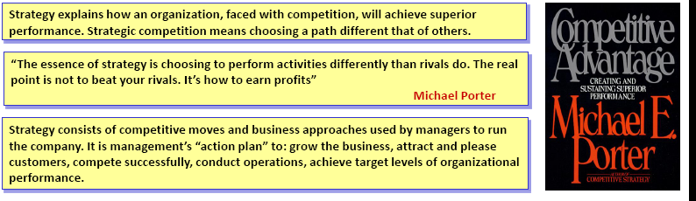
Competitive advantage Five forces Model

Slide 4
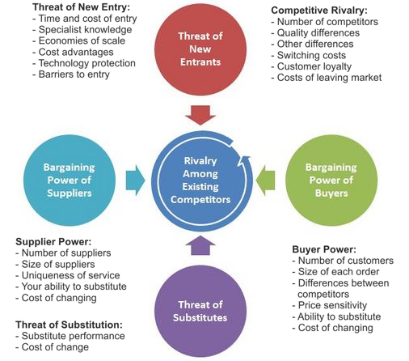
Porter’s Five forces analysis

Slide 5
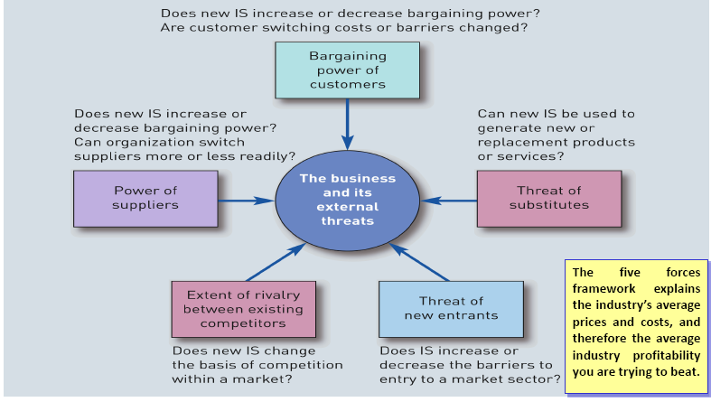
Porter’s Five forces & IT

Slide 6
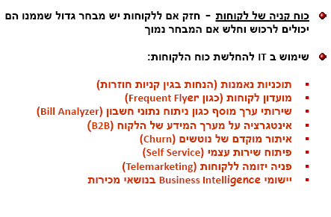
Porter’s Five forces & IT

Slide 7
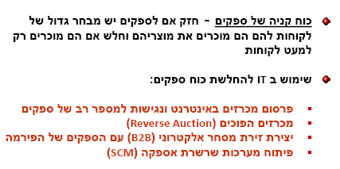
Porter’s Five forces & IT

Slide 8
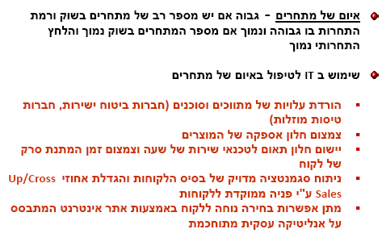
Porter’s Five forces & IT

Slide 9
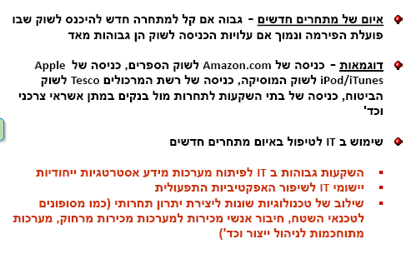
Porter’s Five forces & IT

Slide 10
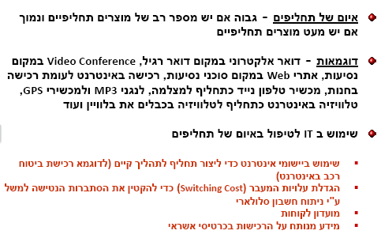
Porter’s Five forces & IT

Slide 11
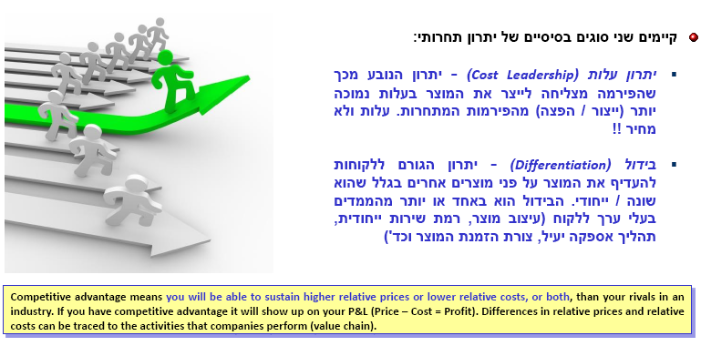
Competitive advantage Types

Slide 12
Understanding Competitors
Strategic objectives of competitors
Differentiation via:
Product line breadth
Product quality
Service support
Distribution channel
Brand
Cost leadership via:
Scale
Experience
Sourcing
Product Innovation
Customer Intimacy
Operating Excellence

Slide 13
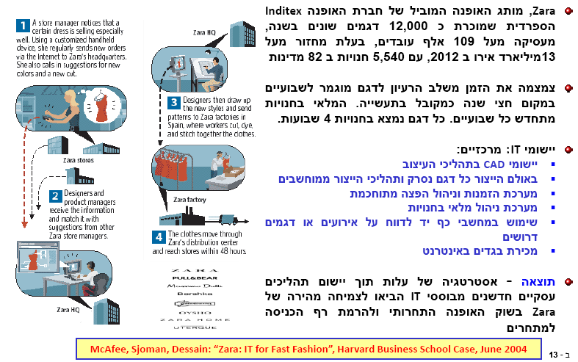
Force – Industry competitors Strategy= Cost

Slide 14
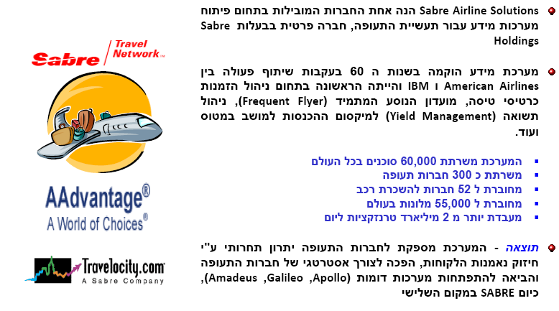
Force – buyers power Strategy= differentiation

Slide 15
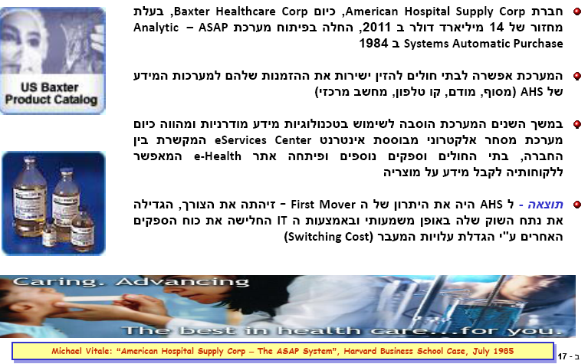
Force – suppliers power Strategy= (switching) cost

Slide 16
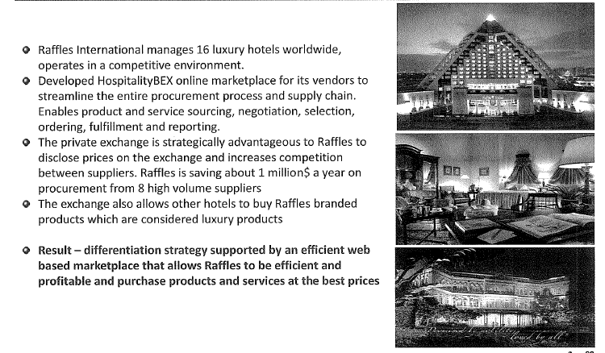
Force – suppliers power Strategy= (switching) cost

Slide 17
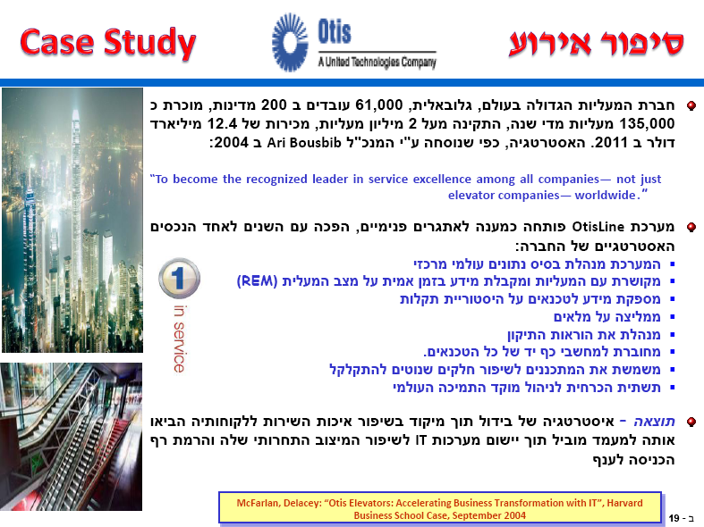
Force – buyers power Strategy= differentiation Force – new entries Strategy – (Entry) cost

Slide 18
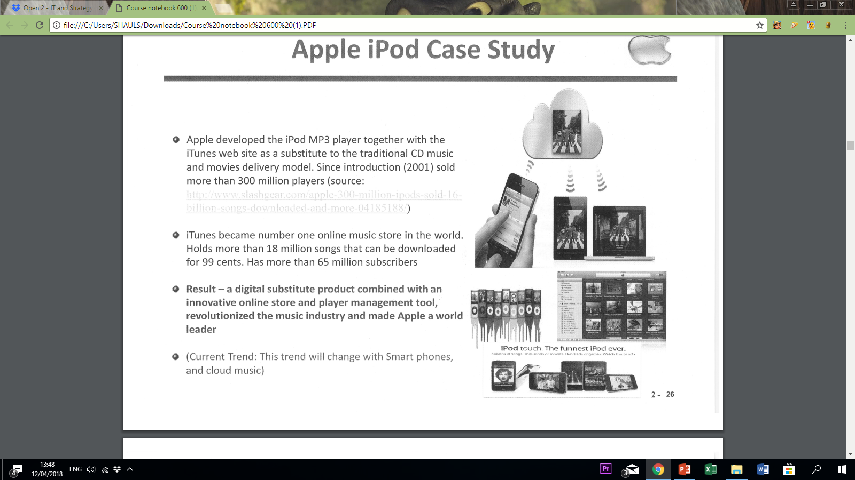
Threats of substitutes – APPLE IPO

Slide 19
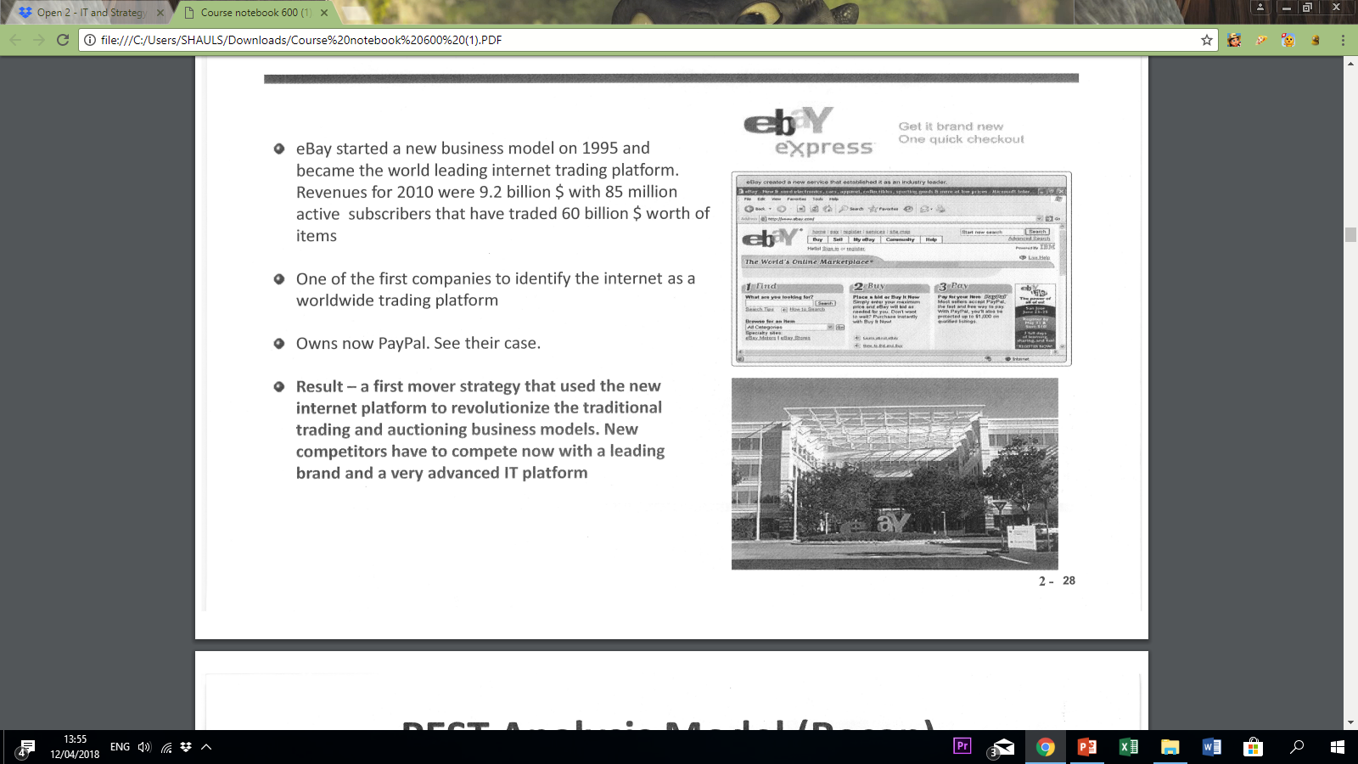
Threats of substitutes – ebay

Slide 20
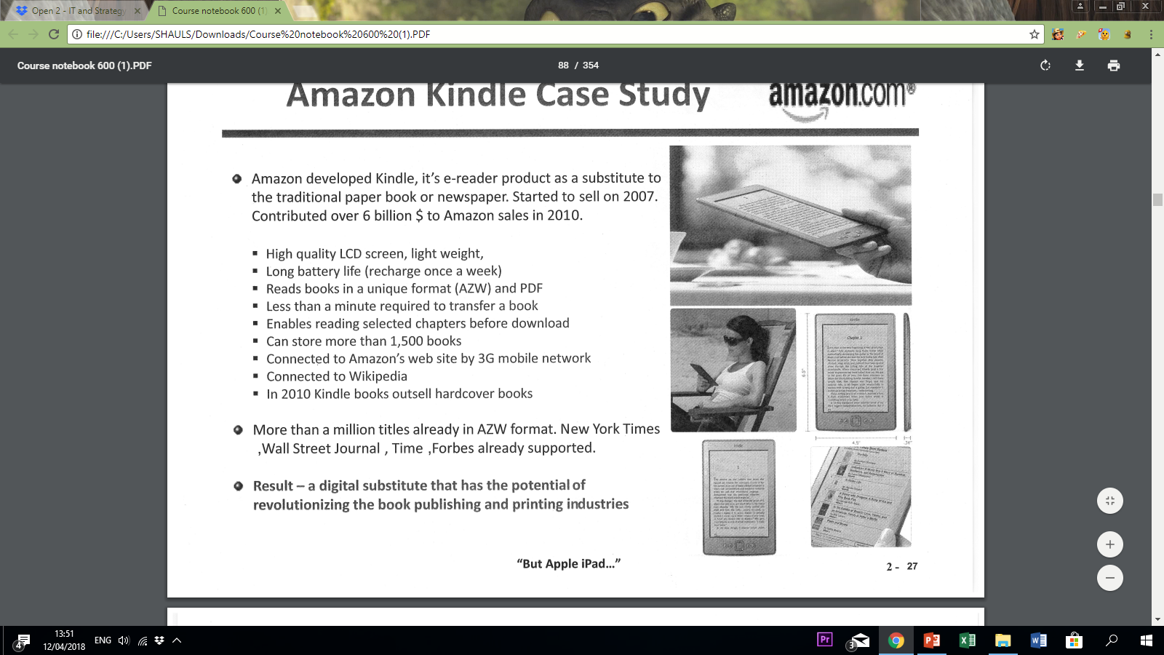
Threats of substitutes – amazon Kindle

Slide 21
Hyper-competition
Often a characteristic of new markets and industries.
Occurs when technologies or offerings are so new that standards and rules are in flux, resulting in competitive advantages that cannot be sustained.
companies must constantly compete in price, quality, innovation, supply chain management, new value creation.

Slide 22
D’Avenis Hypercompetition
the New 7 Ss Framework model
Every advantage is eroded.
Sustaining an advantage can be a deadly distraction.
Goal of advantage should be disruption, not sustainability
Initiatives are achieved through series of small steps

Slide 23
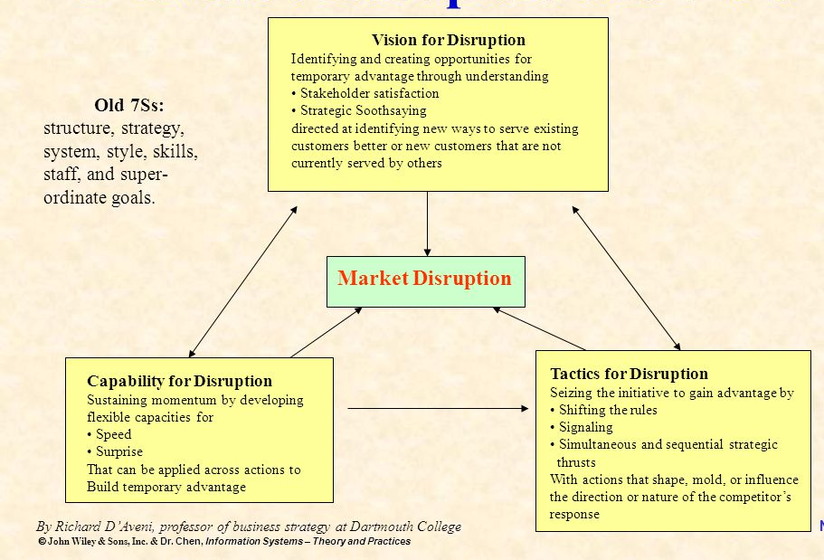
D’Avenis Hyper-competition Triangular

Slide 24
D’Aveni’s new 7 Ss
1. Superior stakeholder satisfaction: maximize customer satisfaction by adding value strategically
2. Strategic soothsaying: use new knowledge to predict new windows of opportunity
3. Positioning for speed: prepare the org. to react as fast as possible
4. Positioning for surprise: surprise competitors
5. Shifting the rules of competition: serve customers in novel ways
6. Signaling strategic intent: communicate intensions in order to stall competitors
7. Simultaneous and sequential strategic thrusts: take steps to stun and confuse competitors in order to disrupt or block their efforts

Slide 25
D’Aveni’s
Strategic Competitive Advantage
Exploitation
Launch
Counterattack
Profits from a
sustained
competitive
advantage
Traditional View
Time
Firm has already moved to advantage 2
Exploitation
Profits from a
series of
actions
Counterattack
Hypercompetition
Time
Launch
Notes:
Intel is a good example of a company that does this. Also the Gillette Sensor / Sensor Excel. In the MarkStrat world - SEMI might be doing well, but need to constantly improve it. Of course in this case it is also becoz consumer preferences are evolving. But if you are not willing to make the change, someone may offer a better product…
Lever 2000 - combined moisturizing, deodorizing and antibacterial effect into a single bar
Toshiba Infinia-changed the concept of the PC. Made access to folks like Donald Trump real
Goal is not to sustain, but to disrupt. Key limitation here is how D’Aveni interprets advantage - if its innovation, then it is sustaining the advantage. If interpreted as a single new product, then disruptive

Slide 26
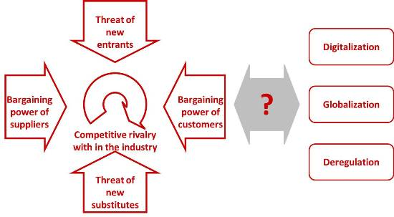
Downes three additional forces

Slide 27
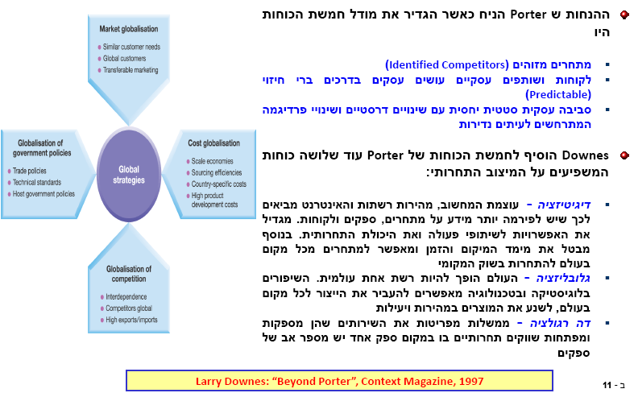
Downes three additional forces

Slide 28
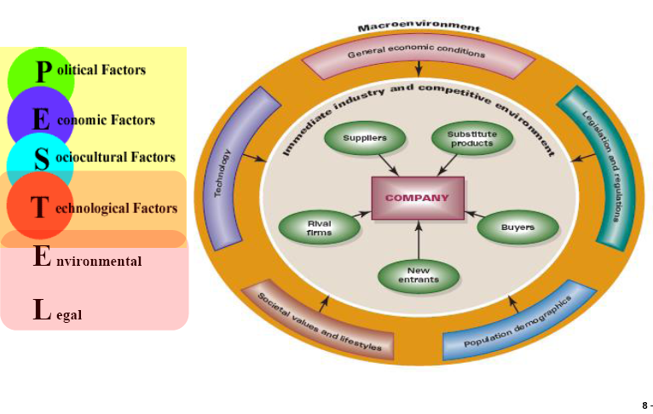
Pestel model

Slide 29
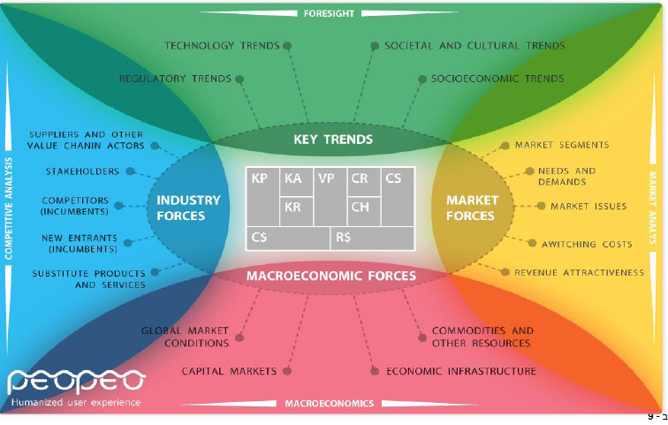
Pestel model

